Slide 1







ANALISIS ALGORITMA
Breadth First Search
Refa Annisa (140810170060)

Slide 2


What is Breadth First Search?
Breadth First Search (BFS) adalah sebuah metode sederhana yang digunakan untuk menelusuri satu per satu node yang ada pada graph sesuai dengan queue yang dibuat berdasarkan level node

Slide 3

Formalisasi Matematis
CLOTHING FOR BABIES AND CHILDREN
Presentations are communication tools that can be used as lectures.
CLOTHING FOR EXPECTANT MOTHERS
Presentations are communication tools that can be used as lectures.
ACCESSORIES FOR CHILDREN
Presentations are communication tools that can be used as lectures.

Slide 4
Paradigma pada BFS
A SLICE OF THE GROWING PIE
Presentations are communication tools that can be used as lectures.

Slide 5
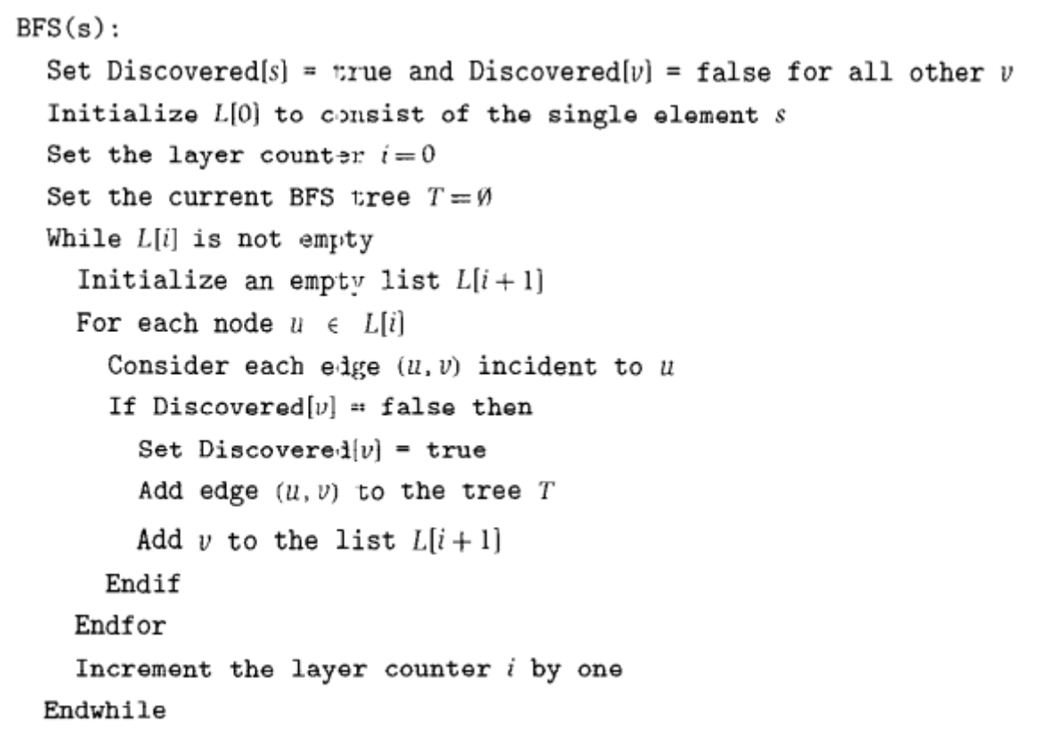
Set all nodes to "not visited";
q = new Queue();
q.enqueue(initial node);
while ( q ≠ empty ) do
{
x = q.dequeue();
if ( x has not been visited )
{
visited[x] = true; // Visit node x !
for ( every edge (x, y) /* we are using all edges ! */ )
if ( y has not been visited )
q.enqueue(y); // Use the edge (x,y) !!!
}
}
PSEUDOCODE
Breadth First Search

Slide 6

BFS C++ Program

Slide 7

BFS C++ PROGRAM
#include<iostream>
using namespace std;
int main(){
int vertexSize = 8;
int adjacency[8][8] = {
{0,1,1,0,0,0,0,0},
{1,0,1,1,1,0,0,0},
{1,1,0,0,1,0,1,1},
{0,1,0,0,1,0,0,0},
{0,1,1,1,0,1,0,0},
{0,0,0,0,1,0,0,0},
{0,0,1,0,0,0,0,1},
{0,0,1,0,0,0,1,0}
};
bool discovered[vertexSize];
for(int i = 0; i < vertexSize; i++){
discovered[i] = false;
}
int output[vertexSize];
//inisialisasi start
discovered[0] = true;
output[0] = 1;
int counter = 1;
for(int i = 0; i < vertexSize; i++){
for(int j = 0; j < vertexSize; j++){
if((adjacency[i][j] == 1)&&(discovered[j] == false)){
output[counter] = j+1;
discovered[j] = true;
counter++;
}
}
}
cout<<"BFS : "<<endl;
for(int i = 0; i < vertexSize; i++){
cout<<output[i]<<" ";
}
}

Slide 8
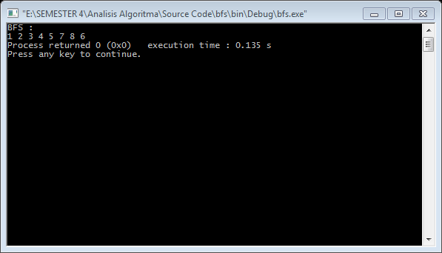
BFS C++ PROGRAM

Slide 9



Implementasi BFS
MAZE
GRAPH
Pencarian jalur terpendek pada game maze
Pencarian jalur terpendek pada simpul graph

Slide 10

Contoh Soal
Adjacency List

Slide 11
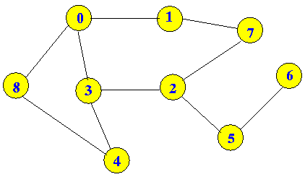

Slide 12
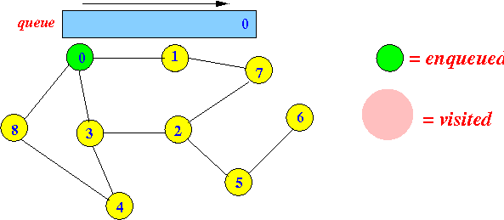
Initial state:
Node 0 enqueued

Slide 13
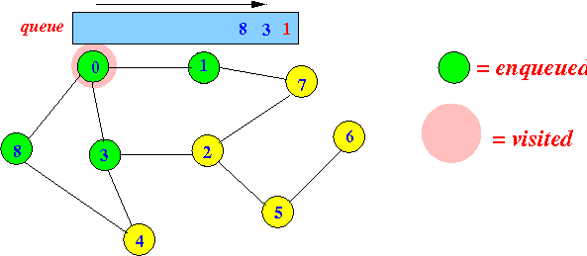
After visiting 0
Enqueue the unvisited neighbor nodes: 8 3 1

Slide 14
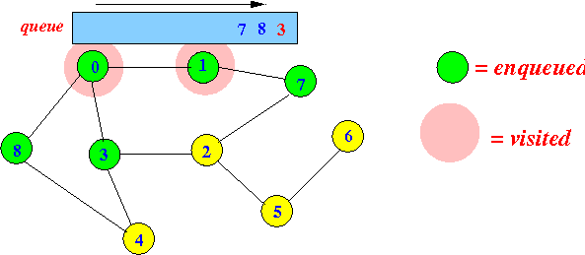
After visiting 1
Enqueue the unvidited neighbor nodes: 7

Slide 15
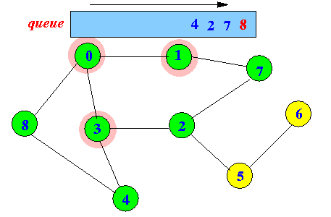
After visiting 3
Enqueue the unvidited neighbor nodes: 2 4

Slide 16
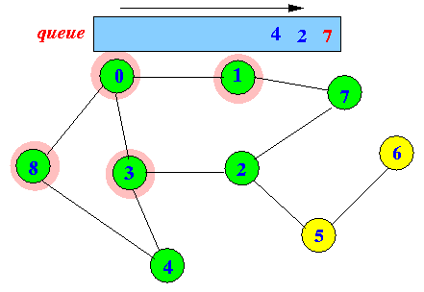
After visiting 8
Enqueue the unvisited neighbor nodes: none

Slide 17
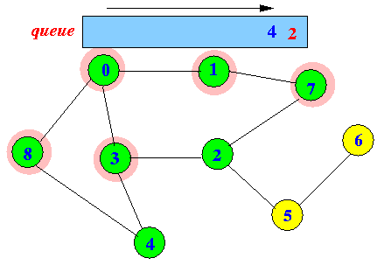
After visiting 7
Enqueue the unvisited neighbor nodes: none

Slide 18
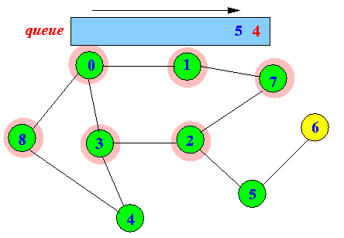
After visiting 2
Enqueue the unvisited neighbor nodes: 5

Slide 19
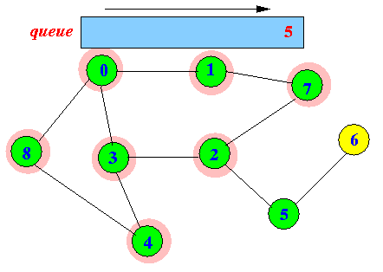
After visiting 4
Enqueue the unvisited neighbor nodes: none

Slide 20
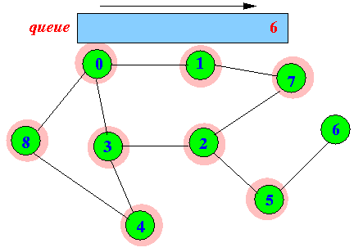
After visiting 5
Enqueue the unvisited neighbor nodes: 6

Slide 21
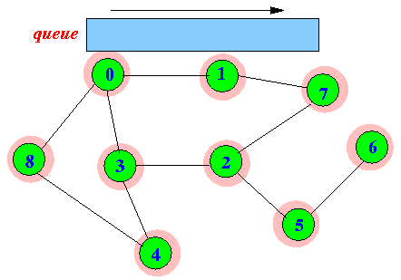
After visiting 6
The BFS is DONE, because the queue is already EMPTY

Slide 22
Contoh Soal
Adjacency Matrix

Slide 23
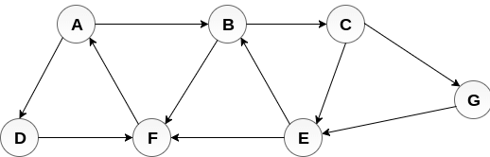
 | A | B | C | D | E | F | G
A | 0 | 1 | 0 | 1 | 0 | 0 | 0
B | 0 | 0 | 1 | 0 | 0 | 1 | 0
C | 0 | 0 | 0 | 0 | 1 | 0 | 1
D | 0 | 0 | 0 | 0 | 0 | 1 | 0
E | 0 | 1 | 0 | 0 | 0 | 1 | 0
F | 1 | 0 | 0 | 0 | 0 | 0 | 0
G | 0 | 0 | 0 | 0 | 1 | 0 | 0

Slide 24

Kompleksitas Algoritma BFS
O(V+E) atau O(V²)
BFS memiliki dua notasi kompleksitas, yaitu O(V+E) serta O(V²). V adalah vertex yang terdapat pada graph BFS dan E adalah edge yang terdapat pada graph BFS.
Yang mendasari kedua notasi pada BFS tersebut adalah data struktur yang merepresentasikan BFS tersebut.

Slide 25
O(V²)
O(V+E)
Kompleksitas O(V+E) adalah kompleksitas dari BFS yang direpresentasikan oleh Adjacency Matrix
Kompleksitas O(V+E) adalah kompleksitas dari BFS yang direpresentasikan oleh Adjacency List

Slide 26
Thank you!

Slide 27
Table of Contents
TOPICS FOR DISCUSSION
Who are we?
What is our "why"?
Whom do we serve?
How do we evolve our strategy?
What is the role of digital advertising?
How to reach us

Slide 28

SOMETHING TO THINK ABOUT
You cannot evolve unless you are willing to change.
- LEON BROWN

Slide 29

Who are we?
ABOUT BAKS CLOTHING COMPANY
Presentations are communication tools that can be used as demonstrations, lectures, speeches, reports, and more.

Slide 30
Flagship Products
CLOTHING FOR BABIES AND CHILDREN
Presentations are communication tools that can be used as lectures.
CLOTHING FOR EXPECTANT MOTHERS
Presentations are communication tools that can be used as lectures.
ACCESSORIES FOR CHILDREN
Presentations are communication tools that can be used as lectures.

Slide 31

Presentations are communication tools that can be used as demonstrations, lectures, speeches, reports, and more.

Slide 32
What is our "why"?
TO CREATE SUSTAINABLE CLOTHING FOR THE GROWING UP YEARS

Slide 33
SLOW, SUSTAINABLE FASHION
FAST FASHION
Presentations are communication tools that can be used as demonstrations, lectures, speeches, reports, and more.
Presentations are communication tools that can be used as demonstrations, lectures, speeches, reports, and more.

Slide 34
Evolution is constant
OUR PRODUCTS EVOLVE AS YOU DO.
Presentations are communication tools that can be used as demonstrations, lectures, speeches, reports, and more.

Slide 35
Item 5
20%
Item 1
20%
Whom do we serve?
CUSTOMER PROFILE
Item 4
20%
Item 2
20%
Presentations are communication tools that can be used as lectures, reports, and more.
Item 3
20%

Slide 36
The BAKS Brand
SEAL OF SUSTAINABILITY
Presentations are communication tools that can be used as lectures, reports, and more.

Slide 37



Customer Touch Points
FACEBOOK
TWITTER
INSTAGRAM
Presentations are communication tools that can be used as lectures.
Presentations are communication tools that can be used as lectures.
Presentations are communication tools that can be used as lectures.

Slide 38

How do we evolve our strategy?
MULTIPLE PLATFORMS
Presentations are communication tools.
CLEARER MESSAGING
Presentations are communication tools.
INDIVIDUALIZED APPROACH
Presentations are communication tools.

Slide 39

Multiple Platforms
IN-STORE EVENTS
Presentations are communication tools that can be used as lectures.
DIGITAL STORE
Presentations are communication tools that can be used as lectures.
SOCIAL MEDIA PRESENCE
Presentations are communication tools that can be used as lectures.
SEAMLESS ONLINE/OFFLINE EXPERIENCE
Presentations are communication tools that can be used as lectures.

Slide 40
1.66 Billion
PEOPLE PURCHASED GOODS ONLINE IN 2017

Slide 41

The Role of Digital Advertising
A SLICE OF THE GROWING PIE
Presentations are communication tools that can be used as lectures.

Slide 42

Digital Touchpoints
Chatbots
MAXIMIZING ONLINE PRESENCE
Dynamic Ads
Online Purchasing

Slide 43
Customer Feedback

Slide 44


KEILA NORITA
New Mother
Presentations are communication tools that can
be used as lectures, reports, and more.

Slide 45

MORRIE HOLLMAN
Husband and Father
Presentations are communication tools that can
﻿be used as lectures, reports, and more.

Slide 46

SERENITY UNGSON
Mother of 3
Presentations are communication tools that can
﻿be used as lectures, reports, and more.

Slide 47
Clearer Messaging
CONSISTENCY
FOCUS
Presentations are communication tools that can be used as lectures, reports, and more.
Presentations are communication tools that can be used as lectures, reports, and more.
EMPATHY
SERVICE
Presentations are communication tools that can be used as lectures, reports, and more.
Presentations are communication tools that can be used as lectures, reports, and more.

Slide 48



INDIVIDUALIZED APPROACH
Presentations are communication tools that can be used as lectures.

Slide 49

The BAKS Experience
Presentations are communication tools that can be used as lectures.

Slide 50
Advertising Strategy Roll-out
TIMELINE AND MILESTONES
1ST QUARTER
2ND QUARTER
3RD QUARTER
Presentations are communication tools.
Presentations are communication tools.
Presentations are communication tools.

Slide 51
Key Targets
REALIGN STRATEGY
Presentations are communication tools that can be used as lectures.
ENSURE ONLINE/OFFLINE COHESIVENESS
Presentations are communication tools that can be used as lectures.
BUILD A COLLABORATIVE ENVIRONMENT
Presentations are communication tools that can be used as lectures.

Slide 52
Meet the Team
SASHA YUSINTA
Chief Marketing Officer
BLAIR COSINGTON
Head of Branding
BIANKA OLLIMAN
Head of Design

Slide 53
Talk to us!
CONTACT INFORMATION
MAIN OFFICE
123 Anywhere St., Any City, State, Country 12345
PHONE NUMBER
123 456 7890
EMAIL ADDRESS
hello@reallygreatsite.com

